Slide 1
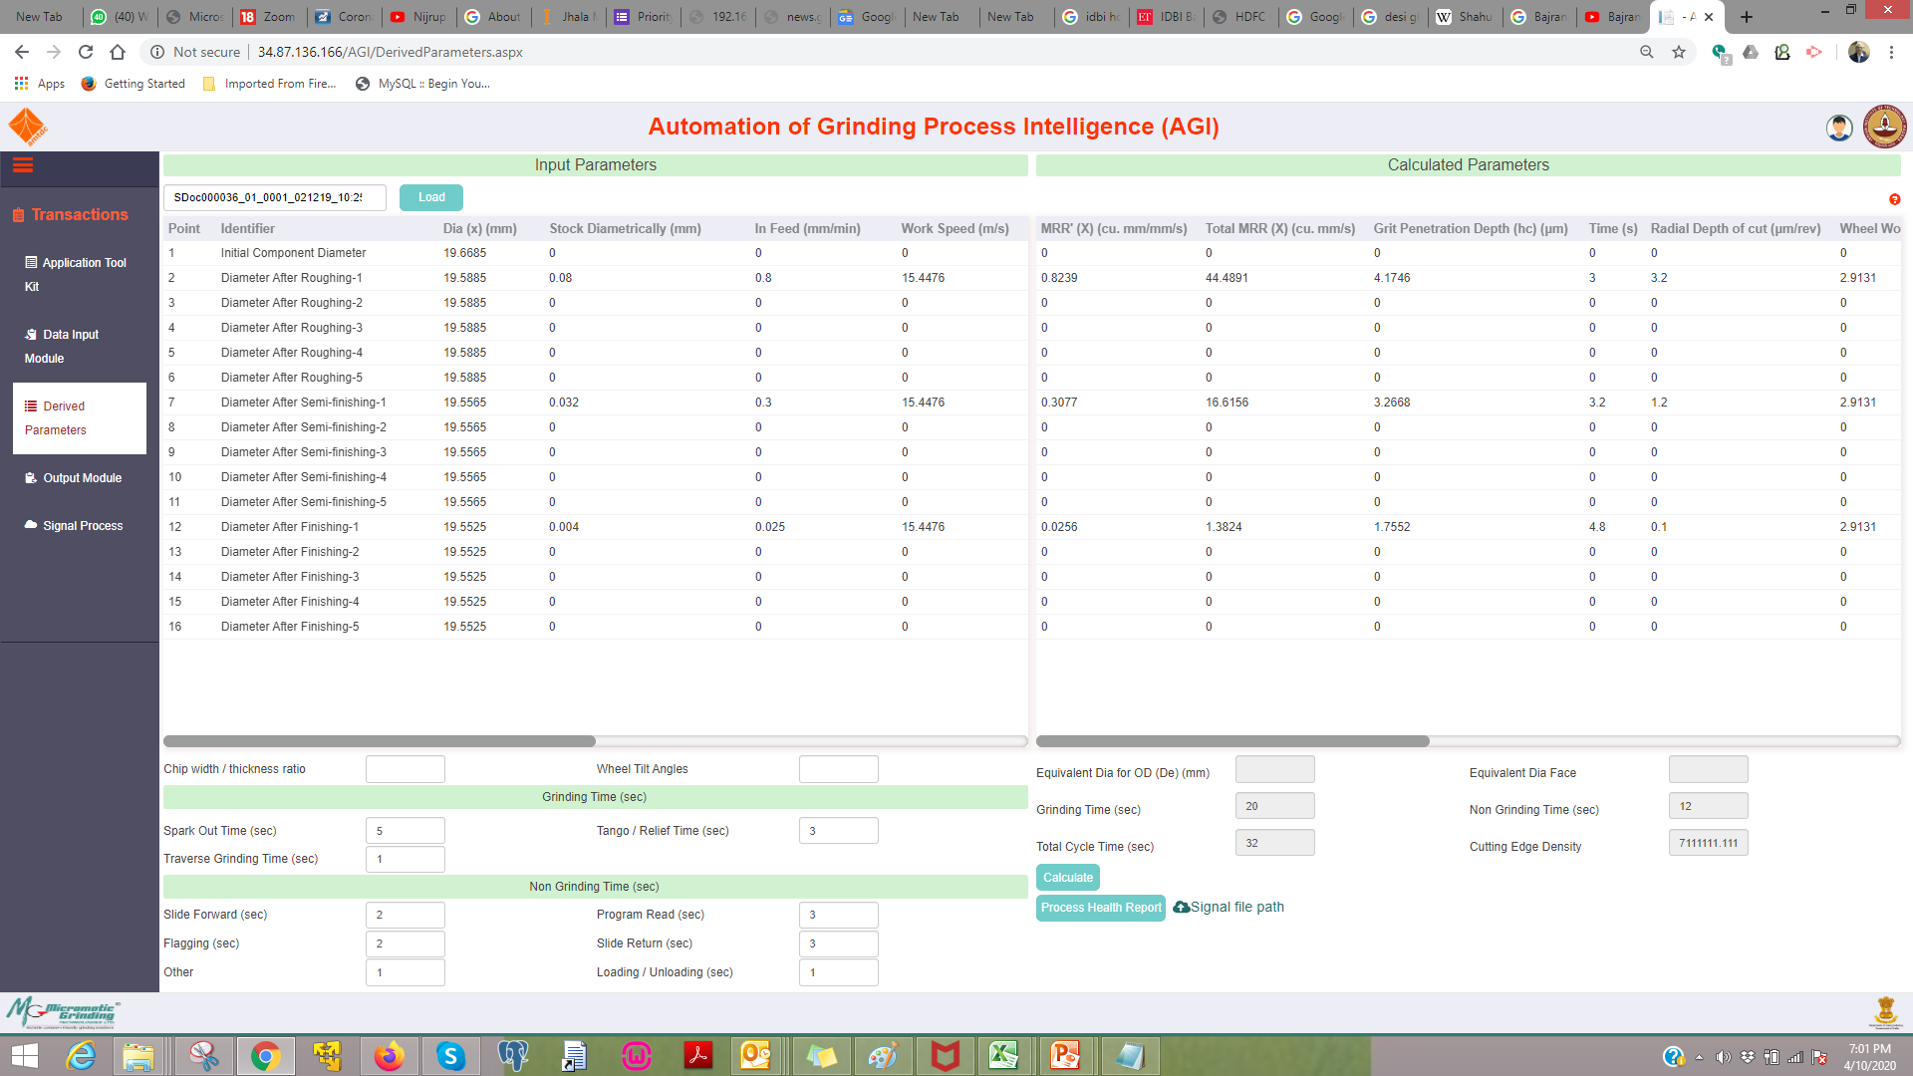
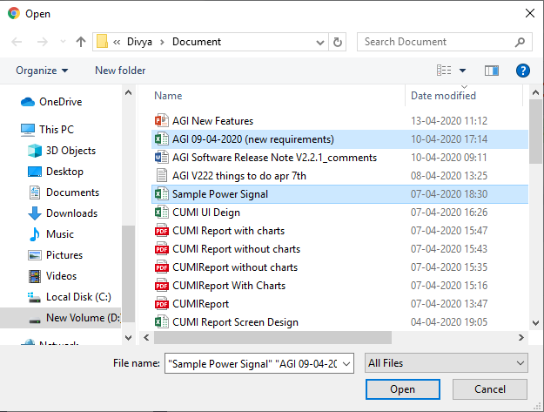
Attachment of signal processing files (1 or more) for System document in Derived Parameters Screen
1. Upload signals in to Data base in local or Cloud.
2. This feature is similar to how images are getting uploaded in the present version
User can select multiple file.
Signal File 00001.xlsx
Signal File 00002.xlsx
Signal File 00003.xlsx
Signal File 00004.xlsx
Signal file upload

Slide 2
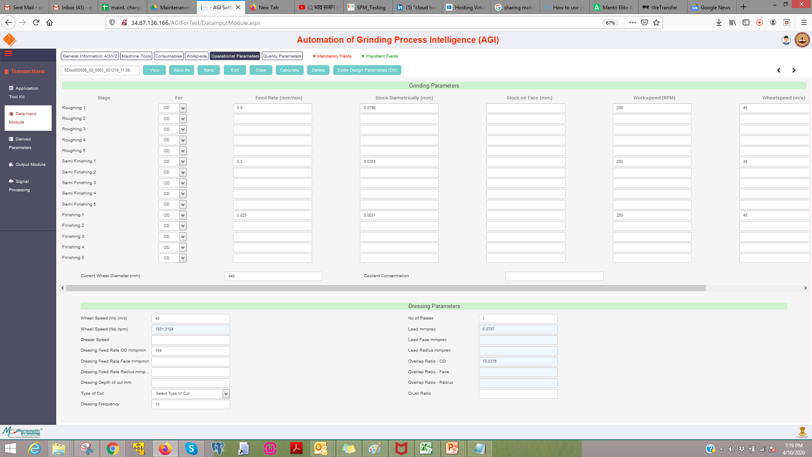
Crush Ratio and Dresser Speed Calculations
1. This is a calculation update.
2. Already the wheel speed and crush ratio parameters are available.
3. Dresser Dia to be added in Consumables tab.
4. Dresser speed (mps) to be added in Operational Parameters tab
5. Dresser speed (RPM) already available
Formula: Crush Ratio = Dresser Speed(mps)/Wheel Speed(mps)
Dresser Speed (mps)
Dresser Speed(mps)=Pi*DresserDia*DresserSpeed(RPM)/60000

Slide 3

Locking and Unlocking system documents
1. One more parameter - Status check box to be added in Derived Parameters Tab
2. This should be saved in the database.
3. If the status parameter is "locked" the buttons should not work and throw a popup saying the system document is locked.
5. If the status is unlocked, it can work normally.
6. The admin option to unlock to be made similar to Delete SDoc feature.

Slide 4
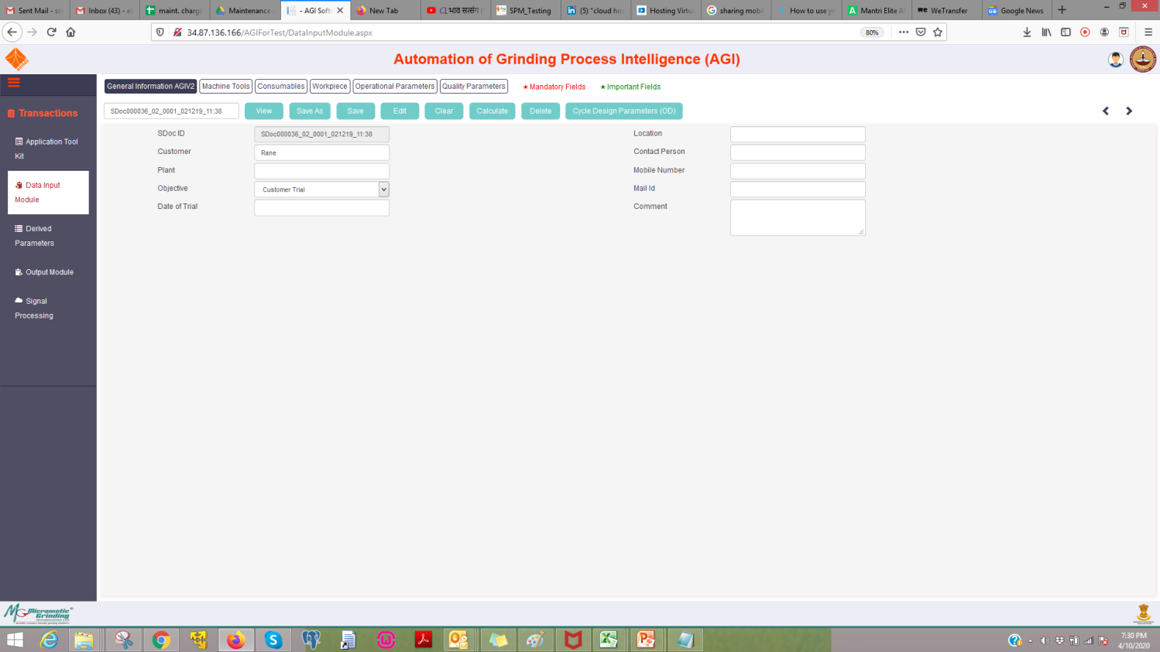
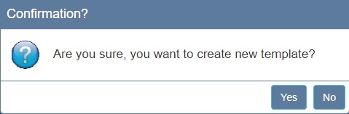

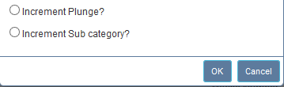
Create standard templates of system documents.
1. There should be a new parameter Template which is a check box.
2. The system document with template checked should be saved as SDoc000 000 and incremented with sub categories.
3. The user will be able to load these standard templates and edit from there
4. A pop up will ask confirmation

